Slide 1

Next up
Cooking Mastery Conference
April 15, 2024
Charlotte, NC

Slide 2
Getting the Word Out
Objective :
Sistas in Sales is interested in empowering males 18-35 with cooking skills, culinary independence, and enhancing healthy eating habits.
The Solution :
A cooking mastery conference “Next Up” will be held in NC centered on empowering young men with cooking skills, promoting culinary independence, and enhancing healthy eating habits.

Slide 3
The Strategy
Drive males (18-35) awareness for ”Next Up” Cooking Mastery Conference
Customize content to make the conference relevant and appeasing to participants
Deliver local impact via endorsements and community partnerships. Partner with local outlets and cooking schools for live demos leading up to conference.
Leverage marketing channels, professional chefs, nutritionists, celebrities, influencers, as trusted resources in the culinary community and develop creative and engaging content centered on incorporating home cooked meals into a busy lifestyle resulting in lifestyle changes.
Resulting in engagement, connection and educational impact.

Slide 4
Go-to-Market Strategy
Goal: create awareness of event and its purpose.
Generate local and surrounding area leads, maximize engagement via social media markets, create engaging content while identifying and outperforming competitors.
Phase 1: Existing Connections
Refer to past Launches, Past Events, Existing Subscribers, Current Partners & Vendors,
Phase 2: New Connections
Develop Timeline and due dates, Set Launch Dates, Cross- Functional Assignments for tasks which include but are not limited to new leads, messaging, partners, vendors, media, influencers, develop messaging
Phase 3: Execution and Evaluation
Checkpoints, Milestones, what is working and what needs to change, if necessary, Post Launch Evaluation

Slide 5
Proposed
Marketing Channels
Local Media- Radio (Power 98 FM, HITS 96.1), Deploy :30 second messages about the event, extend to surrounding areas
Psychographic Networks to target males 18-35
News, Print, Community Partnership & Vendors
Word of Mouth – On the ground demos, event pop ups
Email Marketing-Existing Membership, Future Leads
Social Media Marketing -Instagram, Facebook, Twitch, Twitter, Blogs
Influencer Marketing – Tabitha Brown, Karl Henry, Scotty Scott, Kevin Curry
@wheretoeatCharlotte @CharLitfoodie @Charlottefoodlover
Affiliate and Referral Marketing – Amazon, Instacart
Video Marketing – YouTube, Twitch, Instagram Reels, TikTok Posts
Online Ads – Facebook Targeted Ads, Targeted Display Banners Ads, Twitch
Event Marketing -Airbnb Experiences, Eventbrite
Local Marketing Proposal: More than awareness, we want engagement
Email Campaigns and Marketing
Direct Mail, City of Charlotte, and surrounding areas
Print Advertisement - Charlotte Observer and Charlotte Magazine
Local Sponsors and Vendors, Business Partners
Demos and Small Events leading up to April 15, 2024
Cross Promotion at Similar Events
Objective: Sistas in Sales is interested in reaching males ages 18-35 to educate them on culinary basics and cooking meals that will lead them to a healthier lifestyle.
The Solution: Use Omnichannel Marketing (website, social media, email, events) targeting the audience across all platforms engaging the following topics of sports, technology, business, food, and healthy living. Deploy a campaign using the power of local influencers to amplify the messaging. Monitor and optimize the campaign using attribution tools. Post Event discuss plans for 2025 Next Up Conference.

Slide 6
Expanding our Reach
Live Engagement
Align with Talent
Ads
Local NC Market. & Surrounding Areas
Posted (Recurring) Content
Blogs
Facebook
Streaming Messaging, Podcast, Radio (:30 sec messaging)
Pop Ups & On the Ground Events
Local
Broadcast Radio & Influencers
NC Local Restaurants
Digital Geo-Targeting
NC Local Newspaper &Magazines
Psychographic Networks
(Instagram, TikTok, YouTube Live, Twitch
Facebook, Instagram, Twitch, TikTok
Instagram
SIS Website
SIS Newsletters to Members
Yelp, Google, TripAdvisor, Airbnb Experiences, Groupon

Slide 7
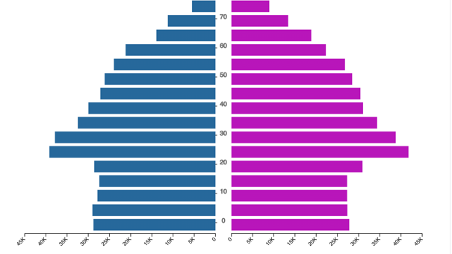
Market Analysis
According to the 2021 US Census, 48.25% of the residents in Charlotte are male with the median male age of 34.5 years old.
There are three upcoming food conferences available for purchase via Eventbrite “Snacks and Sneakers Women Conference”, “NC Mead Alliance Beekeepers and Mead Makers Conference 2024”, and “2024 Cultiv8 Food Systems Summit” none of which target men ages 18-35.
Based on proposal research, competition in this market is nonexistent.

Slide 8
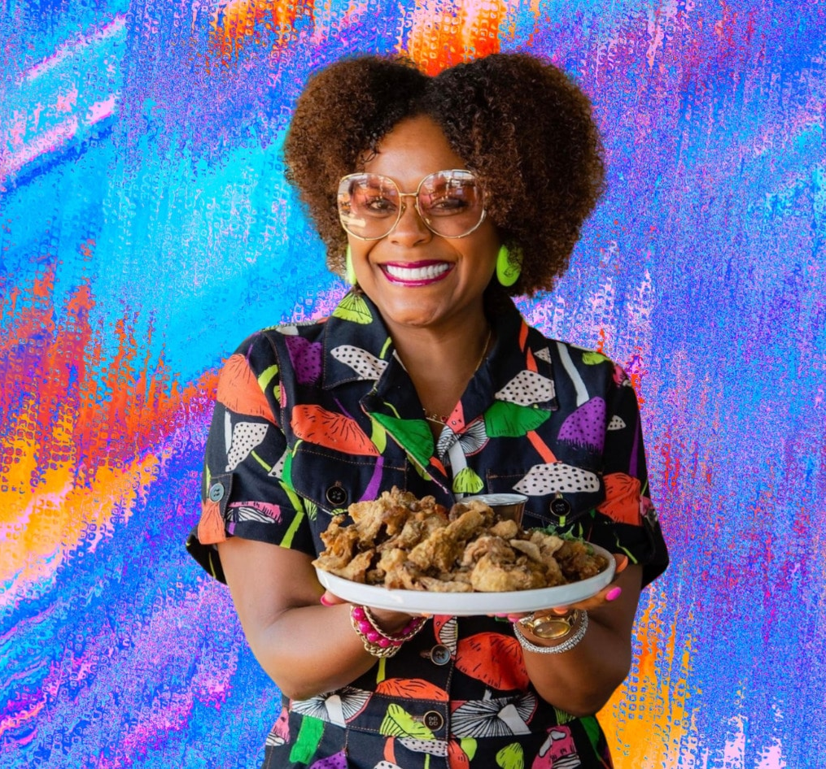
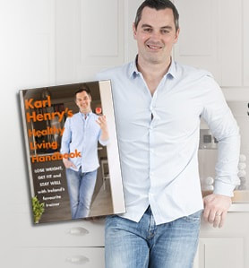
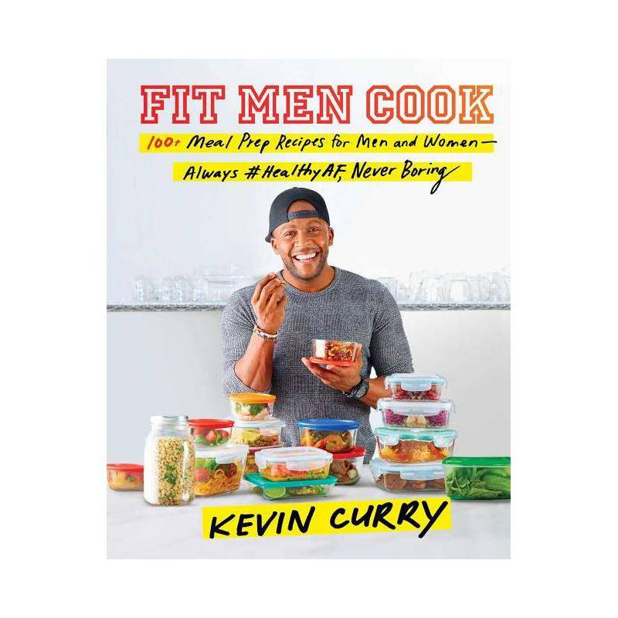
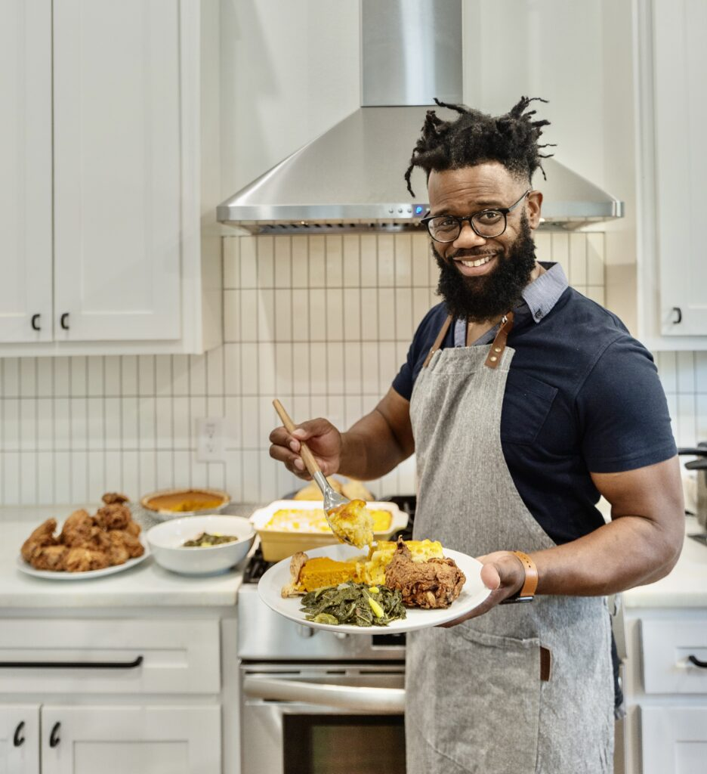
The Influence
Tabitha Brown : 4.3 million followers on IG. American Actress and Social Media Personality. Vegan. Chef. Local to NC. Author.
Karl Henry: 68K Followers on IG. Author of Number One Bestseller which encourages practical, affordable, and a sustainable plan towards well-being. Corporate Wellness Speaker & Podcast Host
Scotty Scott: 51.2k Followers on IG. Grew up in South Carolina, Blogger and Personal Chef in Dallas, TX. Author of 2022 NPR Books we love Fix Me A Plate
Kevin Curry: 1.6 million followers on IG. Fitness Influencer Started on Tumblr in 2012 sharing meals and recipes. Creator of the #1 bestselling Food & Drink App, “FitMenCook” which shares 100 easy, quick, meal prep recipes

Slide 9
Thinking Ahead
KPI’s & Measurement – Tracking & Attribution, Partnership & Endorsement Registration, Hashtags & Geotags
Risk Assessment- Falling Short of Revenue Targets Solution: Dynamic Pricing & BOGO Promos, Push Partnership & Community Involvement
Post-Event Engagement- Takeaway Items (Books, Cooking Supplies, Online Recipe Access, Free Subscriptions to Vendors and Partners, Shopping List, Influencer Engagement

Slide 10
Budget
($80 K estimated)
Budget
Billing Model: This proposal includes an initial participation fee and subscription-based content and format.
Cost
The average cost of existing conferences is $36.
Next Steps:
Determine Cost of “Next Up” Cooking Mastery Conference
What is the overall value of demos, interactions, subscription access, and Next Up?
What is the average cost of conferences in Charlotte, NC? Based on competitors.
What is the target market willing to pay?
Virtual
Streaming Ticket $75pp
Streaming Tech & Crew $15-20K
In-Person
In Person Ticket $150pp
Venue :TBD
Marketing Budget:$15-30K
Vendors & Sponsors : TBD
Local Businesses
Instacart, Amazon, Yelp, Google, TripAdvisor, Airbnb
Radio
Podcast
Streaming
Culinary World - Chefs, Schools, Celebrities, Influencers
Social Media and Ads

Slide 11
Creative Concept “Next Up”
Content Goal: Execute a hyper targeted campaign using audio, display, and video to reach the demographic, foodies, young professionals, gamers, health-conscious individuals to influence website traffic (or ticket sales) for Cooking Mastery Conference.
Solution: Partner with Charlotte Hornets (basketball), Charlotte Panthers (football), or Charlotte Checkers (hockey).
Lean on their community impact and social media influence to advertise for local cooking demos and pop ups leading up to “Next Up” and the big event on April 15th, 2024.

Slide 12
Creative Concept “Next Up”
The Cooking Mastery Conference is titled “Next Up”, which is a phrase commonly used in sports (pickup basketball) to notify other players that you are next on the court to play. The term can also be used socially in reference to someone who is on the rise to success.
“Next Up” Cooking Mastery Conference will be the space for participants to claim their place in the kitchen and to show up confidently.
Using topics such as sports, business, technology, health, and fitness we plan to blend their interests together and reach the targeted demographic. Participants will leave “Next Up” with culinary basics knowledge feeling empowered to create health focused meals.

Slide 13
Creative Concept “Next Up”
Event Venue: depending on athlete and agreement and availability
Spectrum Center Charlotte home of the Charlotte Hornets or Bank of America Stadium home of the Charlotte Panthers
“Next Up” Workshops and Panels will be themed using basketball terms and references
Rebound: | How to bounce back into a healthy routine.
Defense: | How to eat out and choose healthier options.
Free Throw: | Affiliate and Partnership codes for participants, Free Content and Giveaways

Slide 14
Empowerment, Education, Community
With the partnership of the city of Charlotte, NC Sistas is Sales will teach males ages 18-35 how to cook, how to feel confident in their choices, and how to eat the best for their bodies.
One of our goals is to reprogram the mind and eliminate dependence on processed foods and takeout meals.
Using reward systems, encouraging cooking 5-7 meals cooked in home before eating out, providing discounts, cooking demos, and free tutorial/recipes we hope to end poor eating habits and increase overall male health and longevity.

Slide 15
Next up

